Slide 1

Industrial Training
Flutter-Development
Submitted By: Saiyam Sachdeva
Branch: IT - 2(5th Sem)
Roll No: 08813203120
Submitted To:
Mr. Gaurav Sandhu and
Mr. Amandeep Singh

Slide 2
Table Contents
1.) Certification
2.) Description of Training
3.) What is Flutter
4.) What is Cross Platform App Development
5.) Classification
6.) Assests and pubspec of a project
7.) Introduction to Widgets in Flutter
8.)Introduction to Themes in Flutter
9.)Conclusion
2
Notes:
SAY: Before we wrap up the course, let’s review what we have learned today.
During this course, we have
<READ the bullets from the slide.>
GO to next slide.

Slide 3
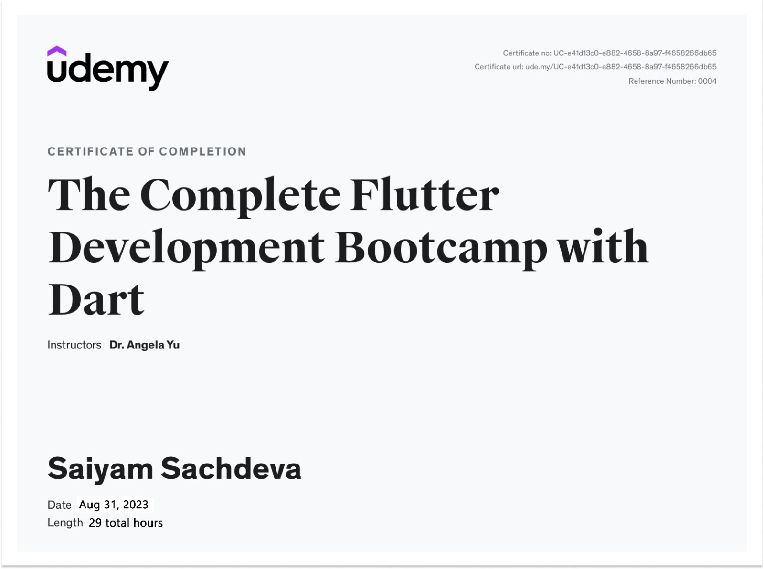
Certification

Slide 4
Description of Training
1.)Introduction to Flutter
2.)Anatomy of Flutter Apps and runing it on Physical Device.
3.)Building Beautifull UI using Flutter Widgets
4.) Asynchronus Functions
5.) Using Dart Packages to speed up Development
6.) Making of MultiScreen Apps using Routes and Navigation
7.) Introduction to packages

Slide 5
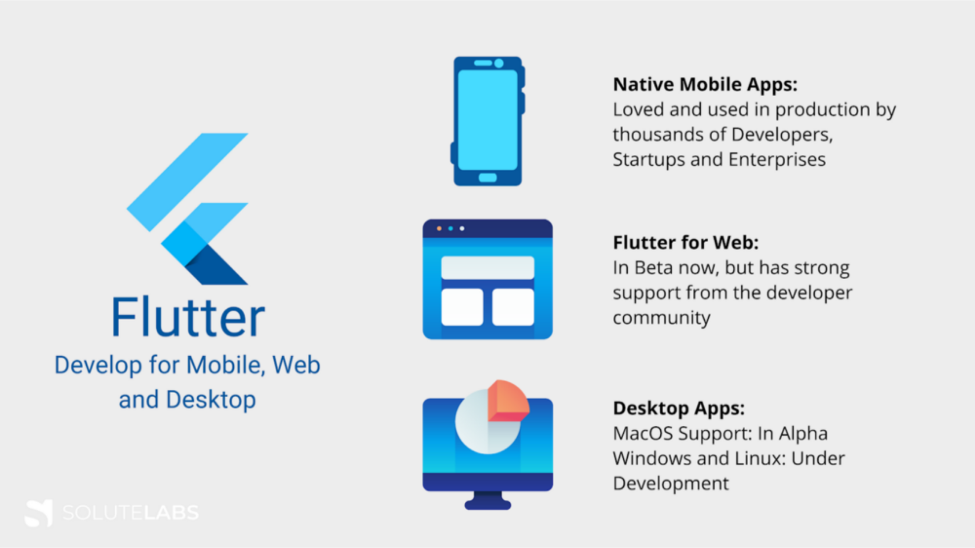
What is Flutter?
Flutter is an open-source software development kit which enables smooth and easy cross-platform mobile app development. You can build high quality natively compiled apps for iOS and Android quickly, without having to write the code for the two apps separately. All you need is one codebase for both platforms.
5
Notes:
SAY: Before we wrap up the course, let’s review what we have learned today.
During this course, we have
<READ the bullets from the slide.>
GO to next slide.

Slide 6
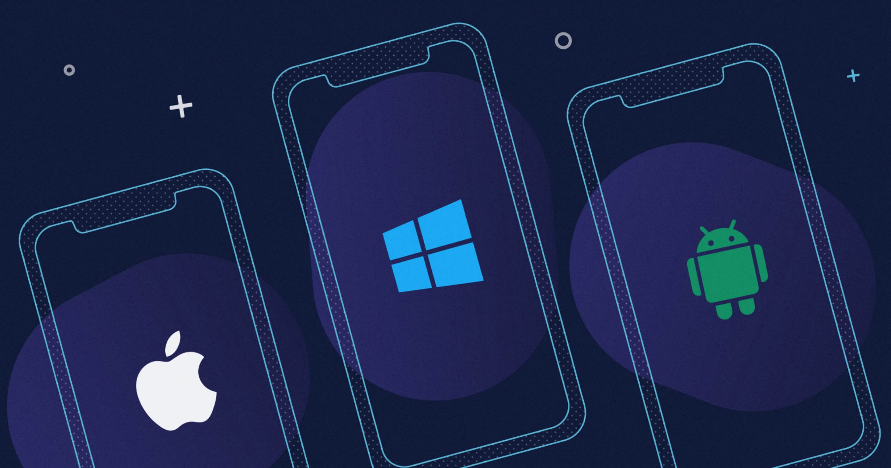
What is Cross Platform App Development
Cross-platform mobile development is the creation of software applications that are compatible with multiple mobile operating systems.It is the creation of an application that works over the internet i.e. websites.
Flutter utilizes a cross platform SDK which allows developers to target many operating systems including Apple platforms, Android, Windows and Linux. Applications built with flutter can also create progressive web applications (PWAs).
6
Notes:
SAY: Before we wrap up the course, let’s review what we have learned today.
During this course, we have
<READ the bullets from the slide.>
GO to next slide.

Slide 7
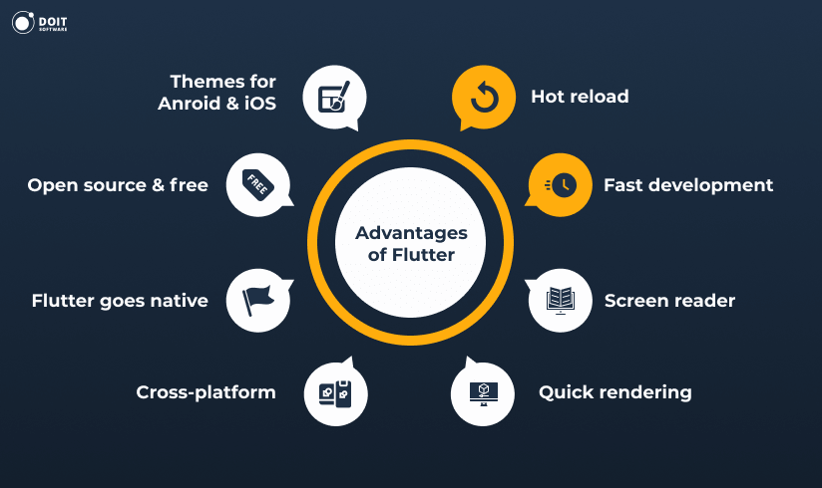
7
Notes:
SAY: Before we wrap up the course, let’s review what we have learned today.
During this course, we have
<READ the bullets from the slide.>
GO to next slide.

Slide 8
Classification
Flutter Development can be classified into two ways:
Frontend Development: The part of a Application that the user interacts directly is termed as front end. It is also referred to as the ‘client side’ of the application.
Backend Development: Backend is the server side of a app. It is the part of the app that users cannot see and interact. It is the portion of software that does not come in direct contact with the users. It is used to store and arrange data.
8
Notes:
SAY: Before we wrap up the course, let’s review what we have learned today.
During this course, we have
<READ the bullets from the slide.>
GO to next slide.

Slide 9
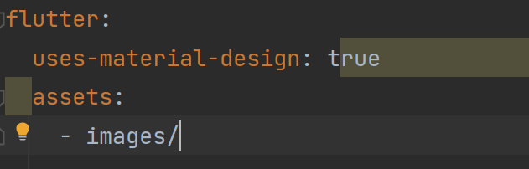
Working on Assets and Pubspec of a Project
1.)In this session we learnt about we learnt about about displaying Images from the Internet in our apps using Network.images(url).
2.) Then we learnt about adding images to our project in a images folder and telling the project that we have imported some images by making changes in pubspec.yaml file and using Asset.images(path).
3.)Every Flutter project includes a pubspec.yaml file, often referred to as the pubspec. A basic pubspec is generated when you create a new Flutter project. It’s located at the top of the project tree and contains metadata about the project that the Dart and Flutter tooling needs to know
9
Notes:
SAY: Before we wrap up the course, let’s review what we have learned today.
During this course, we have
<READ the bullets from the slide.>
GO to next slide.

Slide 10
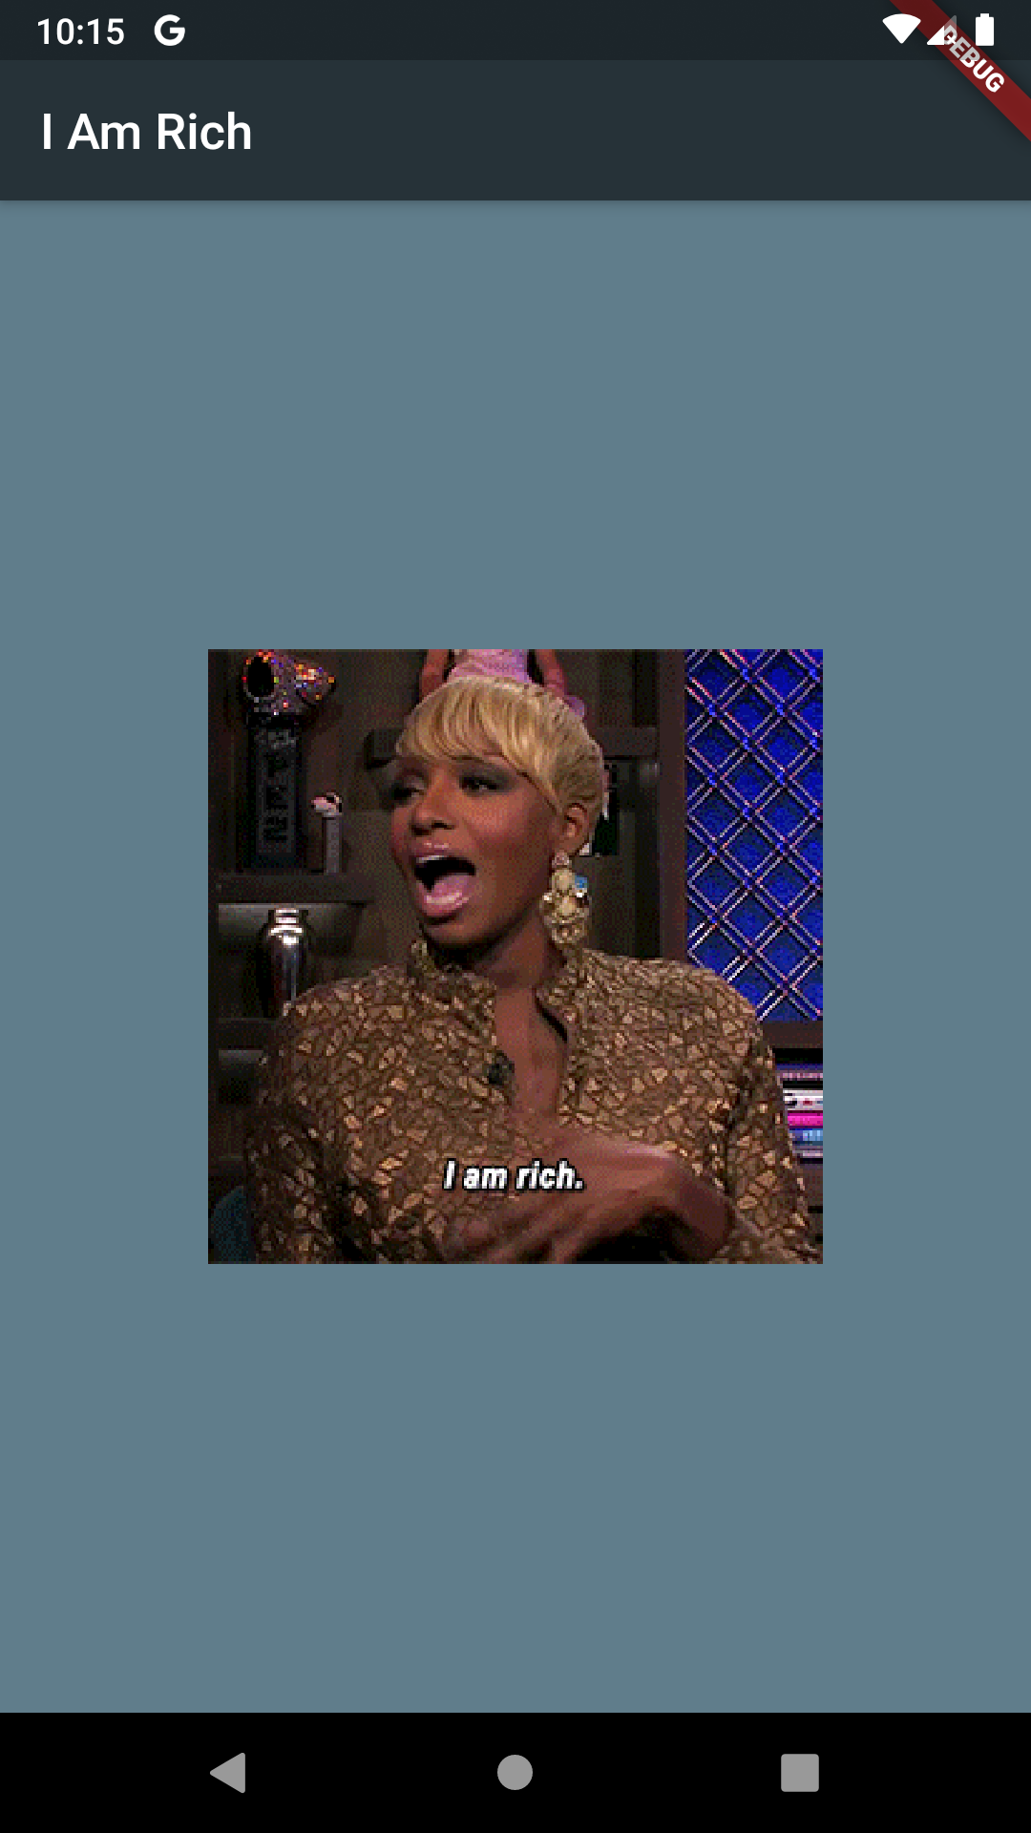
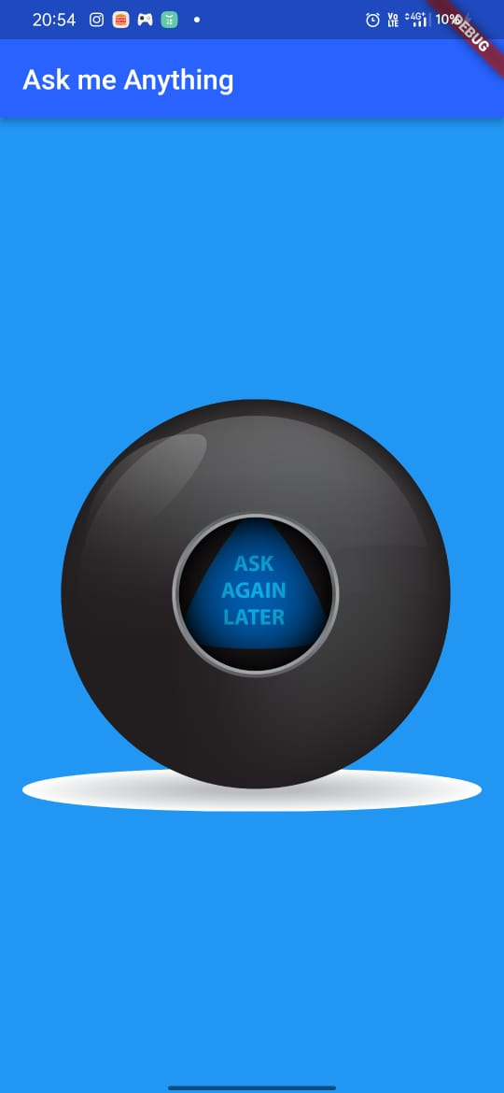
Implementation of App
●●●
10
Notes:
SAY: Before we wrap up the course, let’s review what we have learned today.
During this course, we have
<READ the bullets from the slide.>
GO to next slide.

Slide 11
Introduction to Widgets
1.) In this session we learnt about different types of Widgets and also about packages and made a Contact Card App.
2.) Widgets are the central class hierarchy in the Flutter framework. A widget is an immutable description of part of a user interface. Widgets can be inflated into elements, which manage the underlying render tree.
3.)Few Widgets used in the app are as follows:
Row and Column
CircleAvatar
SizedBox
Text
11
Notes:
SAY: Before we wrap up the course, let’s review what we have learned today.
During this course, we have
<READ the bullets from the slide.>
GO to next slide.

Slide 12
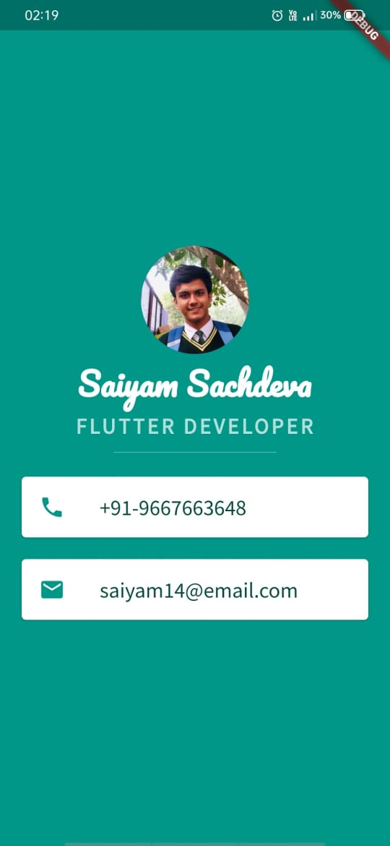
Implementation - Contact App
●●●
12
Notes:
SAY:
The purpose of epidemiology in public health practice is to
discover the agent, host, and environmental factors that affect health;
determine the relative importance of causes of illness, disability, and death;
identify those segments of the population that have the greatest risk from specific causes of ill health; and
evaluate the effectiveness of health programs and services in improving population health.
GO to next slide.

Slide 13
Introduction to Themes
In this session we learnt about Themes in Flutter
Themes are an integral part of UI for any application. Themes are used to design the fonts and colors of an application to make it more presentable.
In Flutter, the Theme widget is used to add themes to an application. One can use it either for a particular part of the application like buttons and navigation bar or define it in the root of the application to use it throughout the entire app.
●●●
13
Notes:
SAY:
The purpose of epidemiology in public health practice is to
discover the agent, host, and environmental factors that affect health;
determine the relative importance of causes of illness, disability, and death;
identify those segments of the population that have the greatest risk from specific causes of ill health; and
evaluate the effectiveness of health programs and services in improving population health.
GO to next slide.

Slide 14
Properties of Themes in Flutter
Properties of Themes in Flutter are as follows:
1.)child: The child property takes in a widget as the object to show below the Theme widget in the widget tree.
2.)data: This property takes in ThemeData class as the object to specify the styling, colors and typography to be used.
3.)isMaterialAppTheme: This property takes in a boolean (final) as the object. If it is set to true then theme uses the material design.
14
Notes:
SAY:
The purpose of epidemiology in public health practice is to
discover the agent, host, and environmental factors that affect health;
determine the relative importance of causes of illness, disability, and death;
identify those segments of the population that have the greatest risk from specific causes of ill health; and
evaluate the effectiveness of health programs and services in improving population health.
GO to next slide.

Slide 15
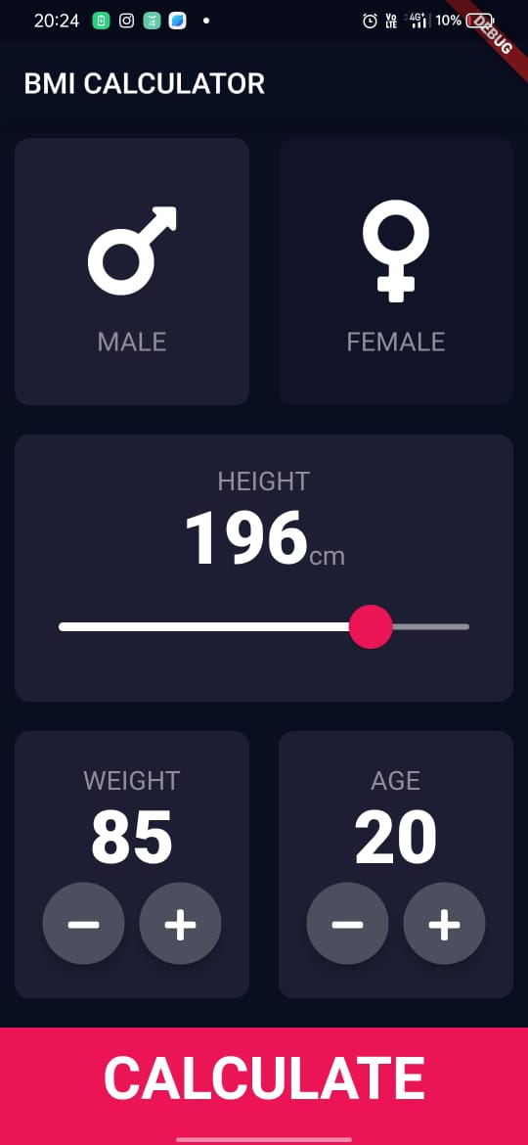
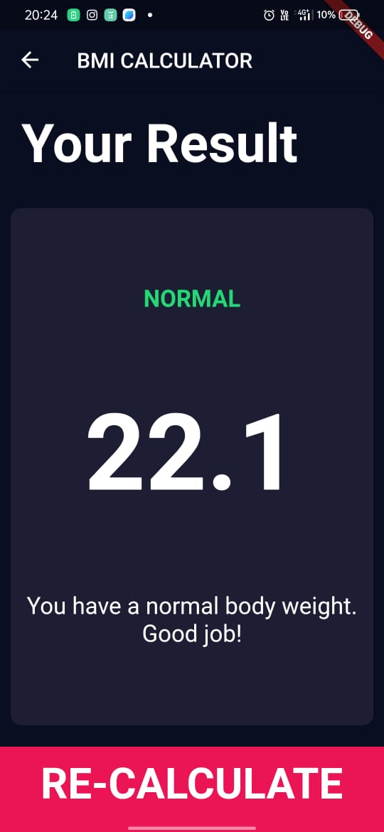
Implementation- BMI Calculator App
15
Notes:
SAY:
The purpose of epidemiology in public health practice is to
discover the agent, host, and environmental factors that affect health;
determine the relative importance of causes of illness, disability, and death;
identify those segments of the population that have the greatest risk from specific causes of ill health; and
evaluate the effectiveness of health programs and services in improving population health.
GO to next slide.

Slide 16
PROJECT -
Chat-Bot Application

Slide 17
Introduction to Packages
In this session we learnt what are packages in flutter and implemented it by making a Chat-Bot App which stores data locally using DialogFlow.
A package is a namespace that contains a group of similar types of classes, interfaces, and sub-packages.
Dialogflow translates end-user text or audio during a conversation to structured data that your apps and services can understand.
17
Notes:
SAY:
The purpose of epidemiology in public health practice is to
discover the agent, host, and environmental factors that affect health;
determine the relative importance of causes of illness, disability, and death;
identify those segments of the population that have the greatest risk from specific causes of ill health; and
evaluate the effectiveness of health programs and services in improving population health.
GO to next slide.

Slide 18
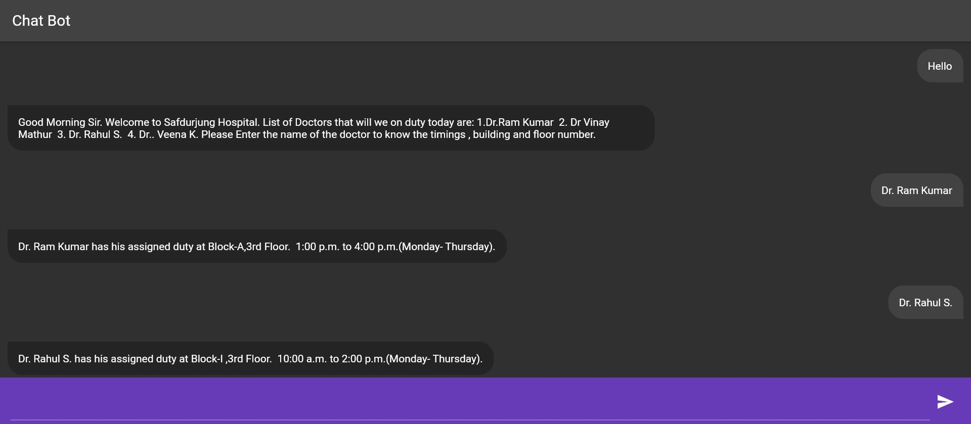
Chat-Bot App
18
Notes:
SAY:
The purpose of epidemiology in public health practice is to
discover the agent, host, and environmental factors that affect health;
determine the relative importance of causes of illness, disability, and death;
identify those segments of the population that have the greatest risk from specific causes of ill health; and
evaluate the effectiveness of health programs and services in improving population health.
GO to next slide.

Slide 19
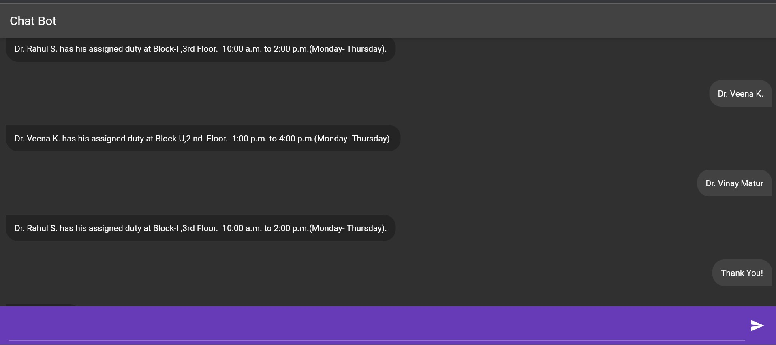
Chat-Bot App

Slide 20
Functionality of the Application
1.Appointment Scheduling:
a. Streamlined Process: The application provides a user-friendly interface to schedule appointments efficiently.
b. Automated Booking: Implemented an automated booking system to reduce manual effort and streamline the entire scheduling process.
2.Chatbot Implementation:
a.Interactive Interface: The Chat-Bot offers an interactive interface for users to communicate and schedule appointments.
User Guidance: Provides guidance to users in scheduling appointments, making the process seamless and user-friendly.
3. Capacity Utilization Enhancement:
a. Strategic Implementation: Spearheaded the implementation of a strategic solution within the chat-Bot to optimize hospital capacity utilization.
b. Increased Efficiency: Resulted in a 25% increase in the hospital's capacity utilization, ensuring optimal use of resources.
20
Notes:
SAY:
The purpose of epidemiology in public health practice is to
discover the agent, host, and environmental factors that affect health;
determine the relative importance of causes of illness, disability, and death;
identify those segments of the population that have the greatest risk from specific causes of ill health; and
evaluate the effectiveness of health programs and services in improving population health.
GO to next slide.

Slide 21
A Chat-Bot App can be helpful for humanity in a number of ways:
1. 24/7 Availability: Chat bots can operate around the clock, providing users with instant assistance and information at any time of day. This is particularly beneficial for businesses with a global audience or users in different time zones.
2. Instant Response: Chat bots deliver immediate responses to user queries, reducing wait times and enhancing the overall user experience. This can lead to higher customer satisfaction and engagement.
3. Scalability: Chat bots can handle a large number of concurrent interactions, making them scalable for businesses experiencing growth in user interactions. They can efficiently manage high volumes of requests without compromising on response time.

Slide 22
A Chat-Bot App can be helpful for humanity in a number of ways:
4. Product Recommendation: Chatbots can analyze user preferences and behaviors to offer personalized product recommendations, enhancing the shopping experience.
5. Order Tracking : User can inquire about the order status, shipping Information, and other details through chatbots.

Slide 23
References
https://pub.get
https://www.wikipedia.org
www.google.com
https://docs.flutter.dev
www.stackoverflow.com
https://docs.hivedb.dev
console.firebase.com
api.flutter.dev

Slide 24
Thank You

